Slide 1


Slide 2






Under supervision :
DR.Wael Zakaria
DR.Mohamed Hashim
TEAM-CODE : KMM
OUR TEAM
Kareem Mohamed
Mohamed Sheta
Mohamed Zenhom

Slide 3


PROJECT OVERVIEW
PROBLEM : -
In the fast-paced world we live in, travelers often face challenges when booking hotels, including:
Time-consuming manual processes.
Limited access to real-time availability.
Lack of a centralized system for comparing options.
These inefficiencies can result in frustration for both customers and hotel staff, ultimately impacting the overall travel experience.

Slide 4
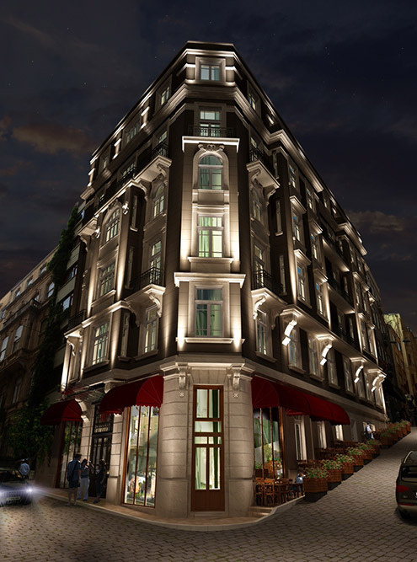

OBJECTIVE : -
The goal of this project is to design and develop an Online Hotel Reservation System that:
Simplifies the hotel booking process by providing an intuitive and user-friendly platform.
Offers real-time availability, pricing, and booking confirmation.
Reduces manual workload for hotel management through automated systems.
This system bridges the gap between travelers and hotels, ensuring a seamless and efficient booking experience.
OUR SERVICES

Slide 5


KEY POINTS OF THE SCHEMA
Main Entities:
Hotel: Represents hotels with attributes like Name, Location, ID, Manager, etc.
Employee: Contains employee details, linked to hotels by Hotel_ID.
Guest: Stores guest information, crucial for reservations and reviews.
Owner: Tracks ownership details for hotels.
Reservations:
Book_Room: Manages room bookings, including dates, payment methods, and reviews.
Book_Hall: Handles hall bookings with timing and date details.
Services & Facilities:
Hotel_service: Links hotels to specific services they offer.
Room & Hall: Define details about rooms and halls like pricing, capacity, and availability.
Relationships:
Well-defined primary keys and composite keys to establish many-to-one and many-to-many relationships.
Dependent Table: Tracks employees' dependents, which adds a layer of HR functionality to the system.

Slide 6
SCHEMA CONTENTS
Owner
Employee
Guest
Attributes:
Fname: First name.
minit: Middle initial.
Lname: Last name.
SSN: Social Security Number (Primary Key).
phone: Contact number.
sex: Gender.
Bdate: Date of birth.
Nationality: Nationality.
Attributes:
Fname: First name.
minit: Middle initial.
Lname: Last name.
SSN: Social Security Number (Primary Key).
phone: Contact number.
salary: Employee’s salary.
sex: Gender.
Bdate: Date of birth.
Nationality: Nationality of the employee.
jop_description: Job title or role in the hotel.
Address: Residential address.
Hotel_ID: ID of the hotel where the employee works.
Super_ssn: Supervisor's SSN.
Attributes:
Fname: First name.
minit: Middle initial.
Lname: Last name.
SSN: Social Security Number (Primary Key).
phone: Contact number.
sex: Gender.
Bdate: Date of birth.
Nationality: Nationality.
Email: Email address for communication.

Slide 7
SCHEMA CONTENTS
Hotel
Hotel_service
Room
Attributes:
Name: Name of the hotel.
phone: Contact number of the hotel.
Location: Address or location of the hotel.
ID: Unique identifier for each hotel (Primary Key).
Total_num_of_rooms: Total rooms available in the hotel.
Total_num_of_halls: Total halls available in the hotel.
num_of_free_rooms: Number of rooms currently available for booking.
num_of_free_halls: Number of halls currently available for booking.
MGR_SSN: Manager's Social Security Number (SSN).
MGR_start_date: Date when the manager started managing the hotel.
Attributes:
Service: Name of the service (e.g., Wi-Fi, Spa).
Hotel_ID: ID of the hotel providing the service. (Primary Key: Service, Hotel_ID).
Attributes:
Type: Type of the room (e.g., Single, Double).
price: Price per night.
Room_num: Unique room number (Primary Key: Room_num, Hotel_ID).
Floor: Floor where the room is located.
Hotel_ID: ID of the hotel where the room is located.
Hall
Attributes:
Capacity: Maximum capacity of the hall.
Hall_num: Unique hall number (Primary Key: Hall_num, Hotel_ID).
Hotel_ID: ID of the hotel where the hall is located.

Slide 8
SCHEMA CONTENTS
Dependent
Own
Review
Attributes:
name: Name of the dependent.
Address: Address of the dependent.
sex: Gender.
phone: Contact number.
Bdate: Date of birth.
Relation: Relationship to the employee.
Employee_SSN: SSN of the employee. (Primary Key: name, Employee_SSN).
Attributes:
Owner_SSN: Owner’s SSN.
Hotel_ID: Hotel ID they own. (Primary Key: Owner_SSN, Hotel_ID).
Attributes:
Hotel_ID: ID of the hotel being reviewed.
Guest_SSN: SSN of the guest leaving the review.
Rate_stars: Rating provided by the guest. (Primary Key: Hotel_ID, Guest_SSN).
Book_Room
Book_Hall
Attributes:
Guest_SSN: SSN of the guest.
Room_num: Number of the room being booked.
Hotel_ID: Hotel ID where the room is located.
Check_in_date: Check-in date.
Check_out_date: Check-out date.
Amount: Amount paid for the booking.
Review: Optional review for the room.
Code: Booking code for reference.
Pay_method: Payment method used. (Primary Key: Guest_SSN, Room_num, Hotel_ID).
Attributes:
Guest_SSN: SSN of the guest.
Hall_num: Number of the hall being booked.
Hotel_ID: Hotel ID where the hall is located.
Date: Booking date.
Time: Booking time. (Primary Key: Guest_SSN, Hall_num, Hotel_ID).

Slide 9
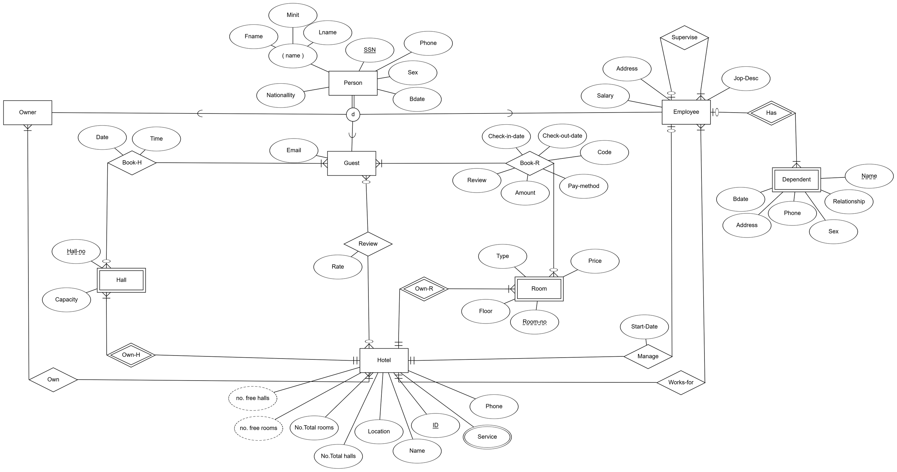
ُER_MODEL

Slide 10
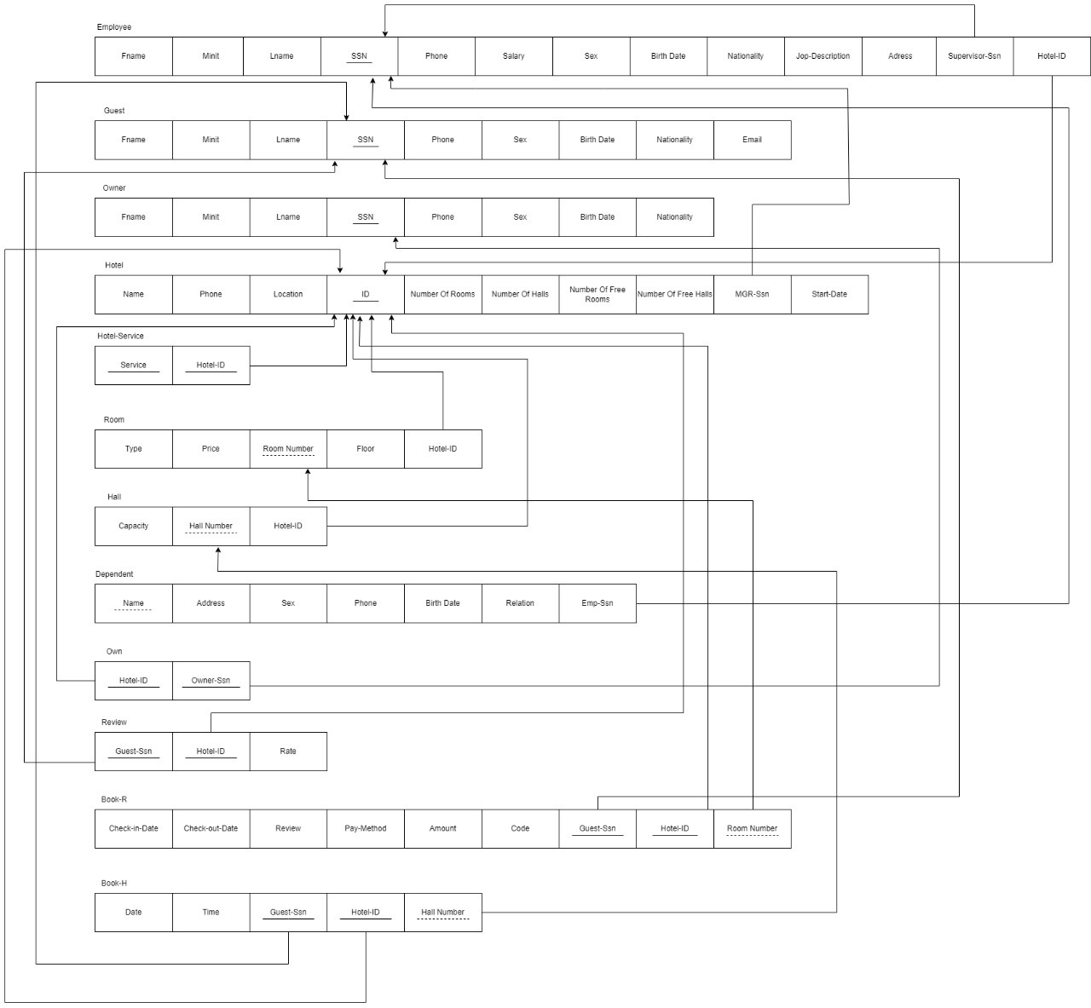
Relational model

Slide 11
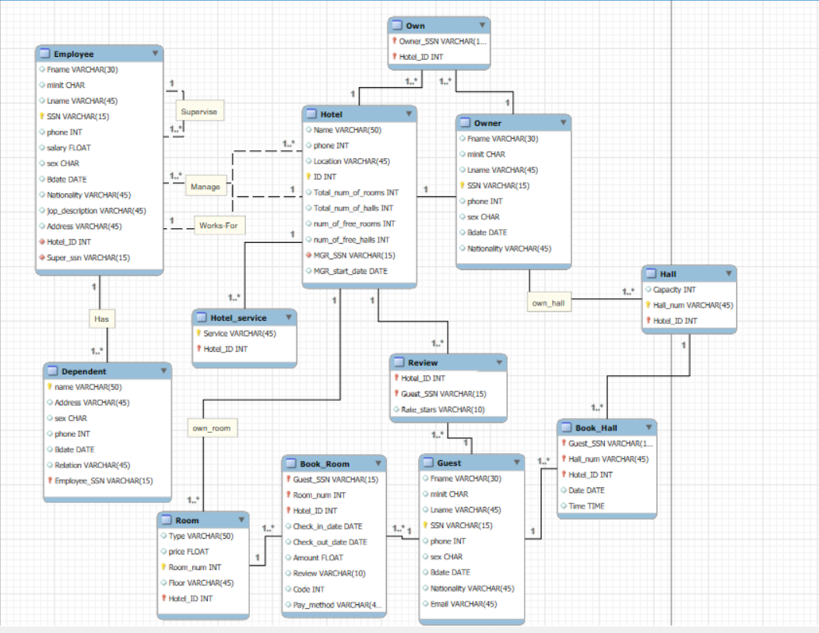
ُER_MODEL
Schema

Slide 12
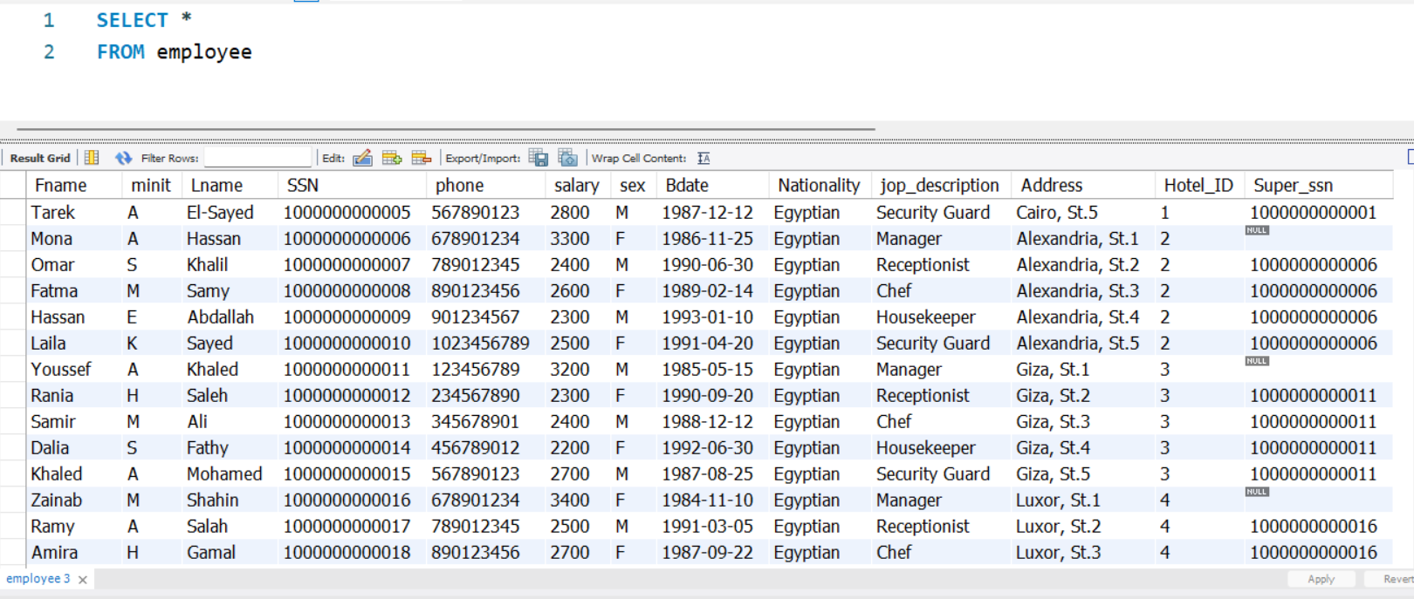
Employee Data

Slide 13
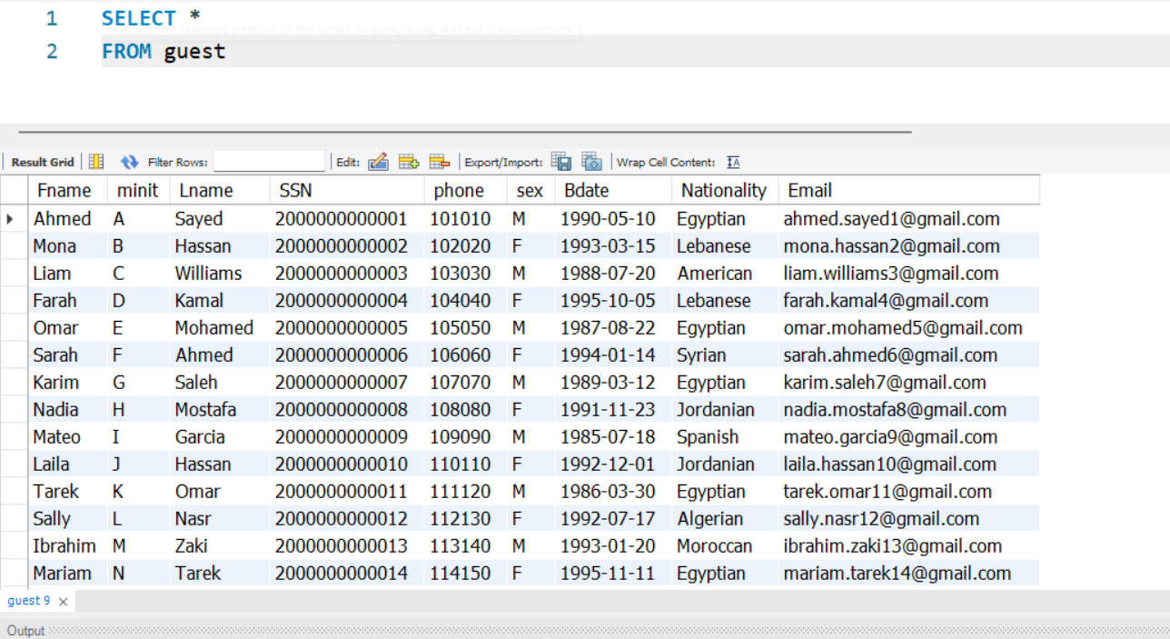
Guest Data

Slide 14
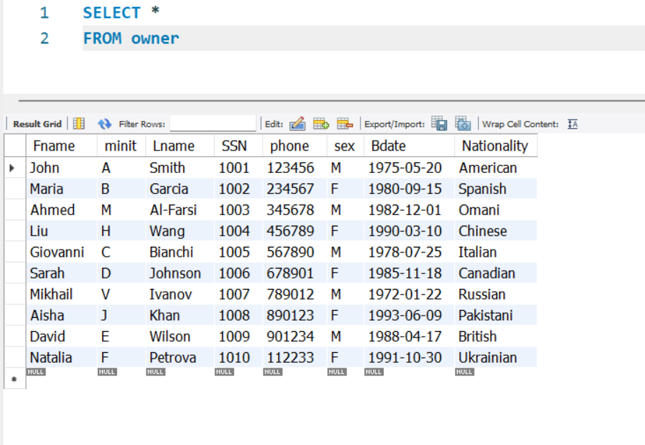
Owner Data

Slide 15
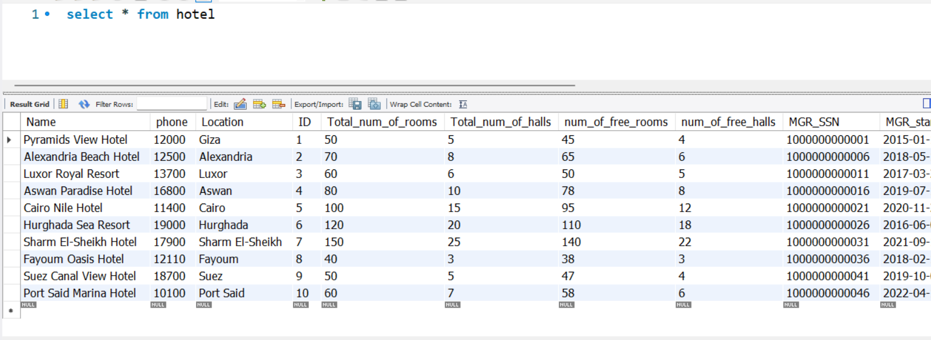
Hotel Data

Slide 16
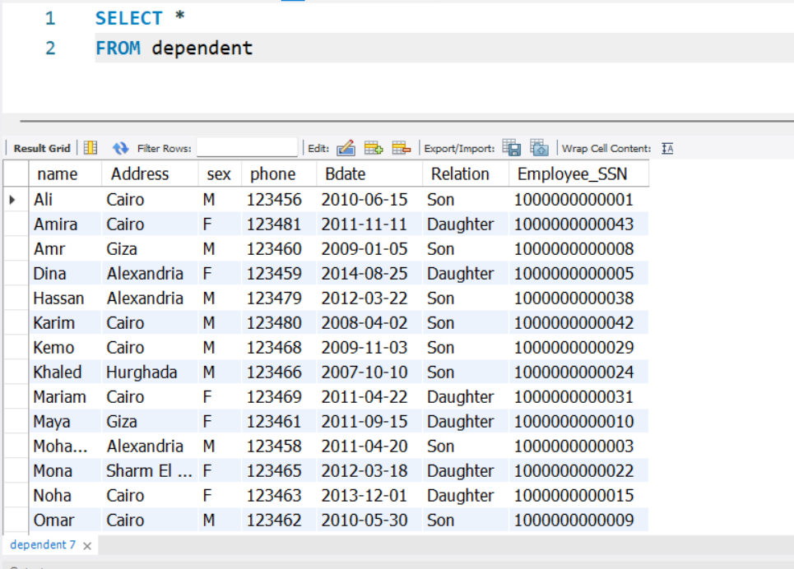
Dependent Data

Slide 17
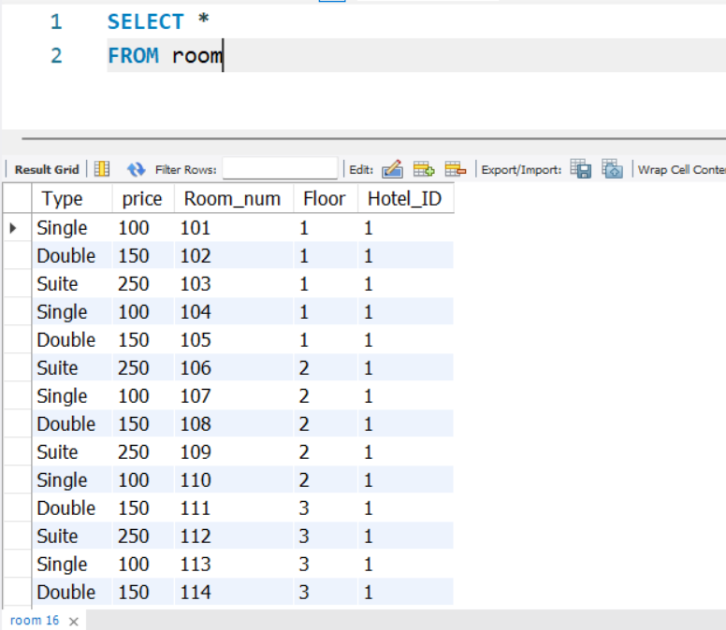
Room Data

Slide 18
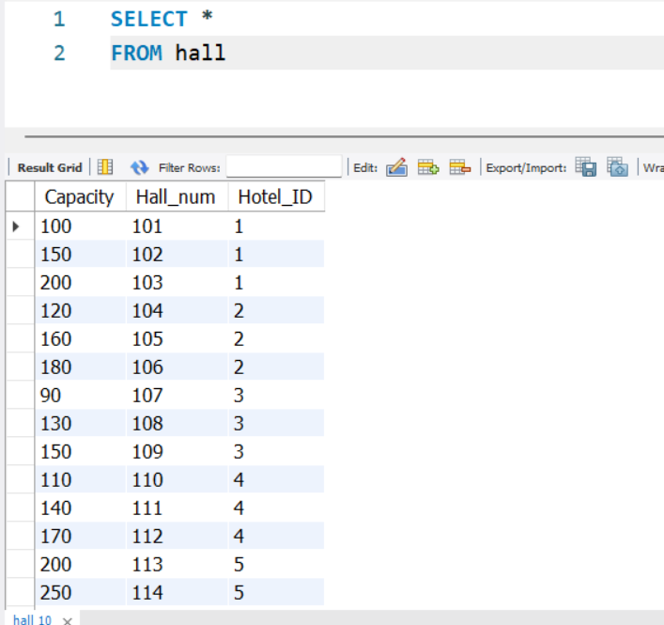
Hall Data

Slide 19
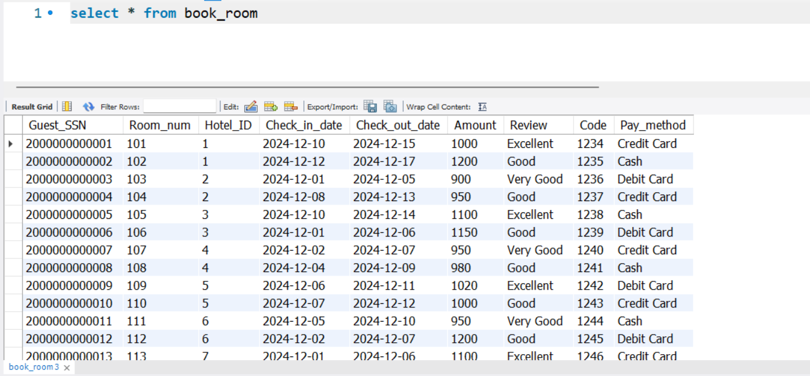
Book_Room Data

Slide 20
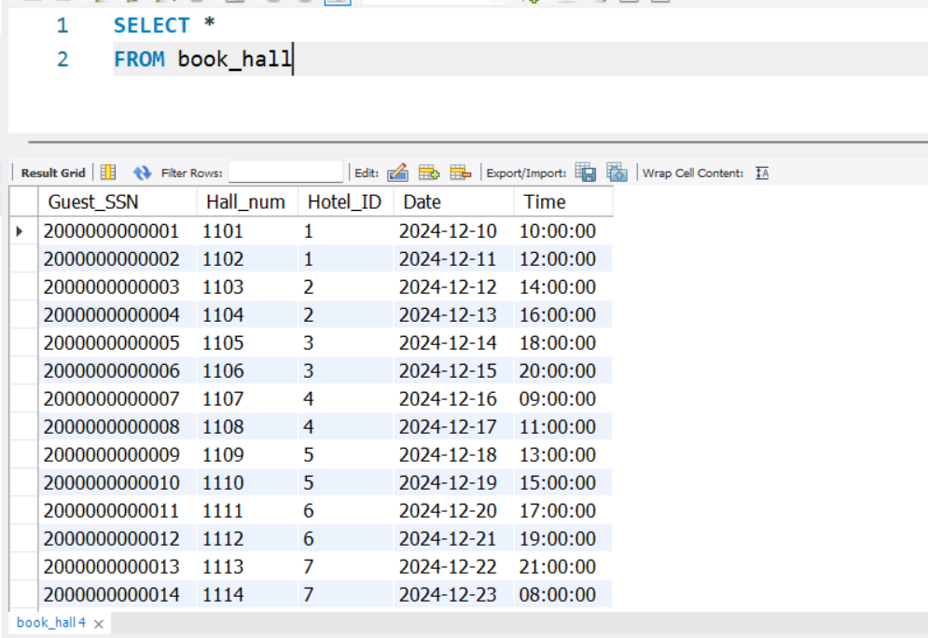
Book_Hall Data

Slide 21
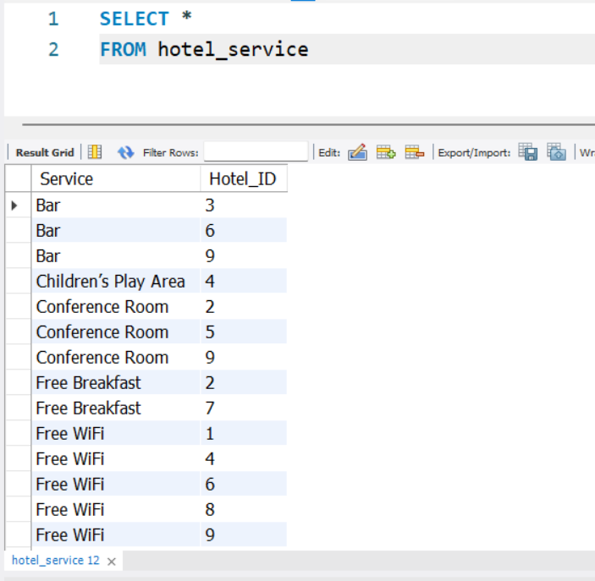
Hotel_Service Data

Slide 22
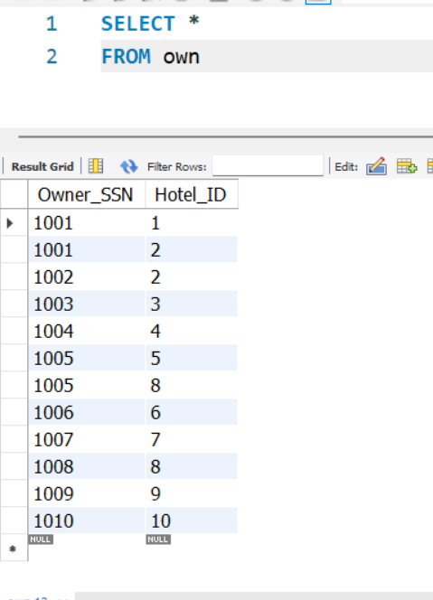
Own Data

Slide 23
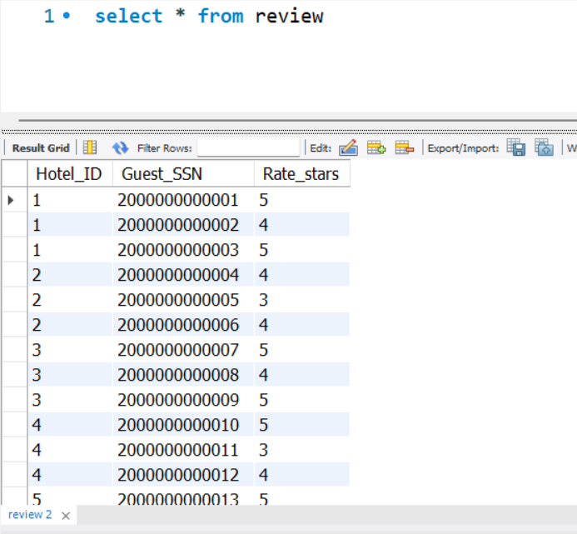
Review Data

Slide 24
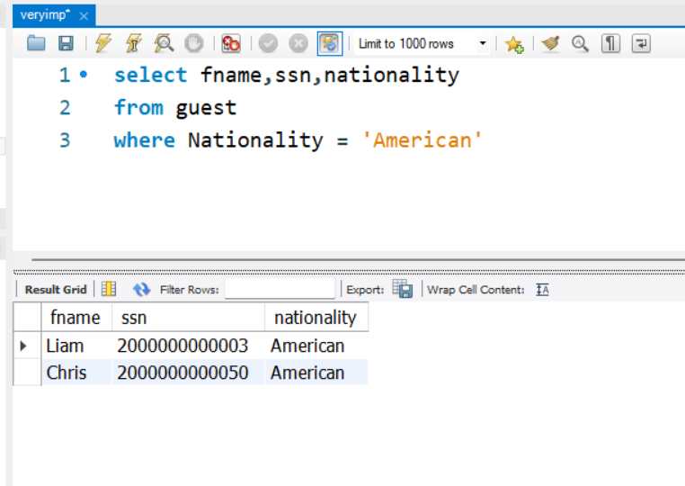
Query 1
1) retrieve the Name , SSN and Nationality for American Guestes

Slide 25
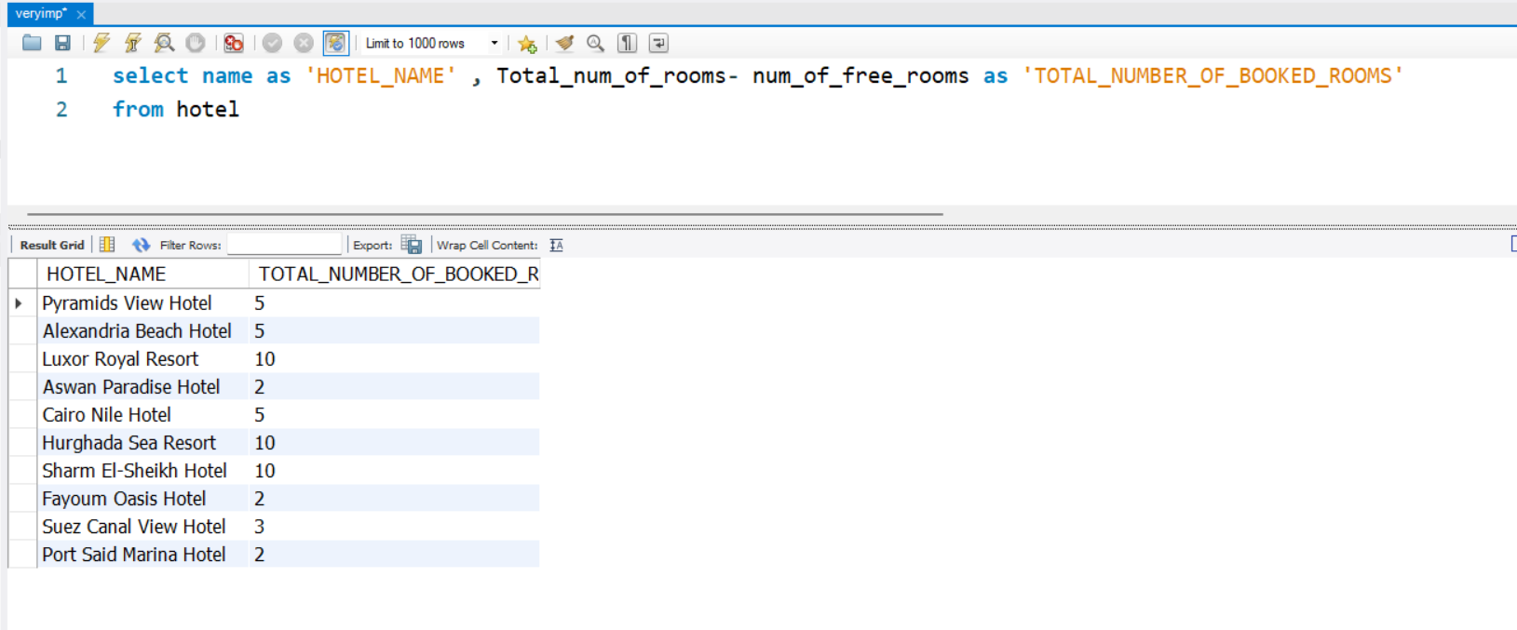
Query 2
2) retrieve the Total Number of Booked Rooms in each hotel

Slide 26
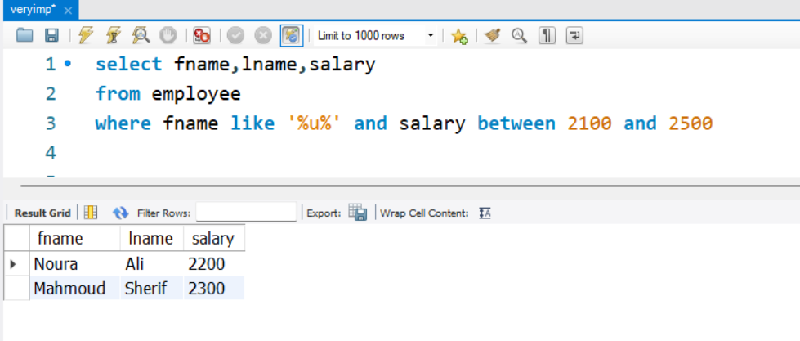
Query 3
3) retrieve the name of employee who has letter (u) in his/her name and have salary between 2100 and 2500

Slide 27
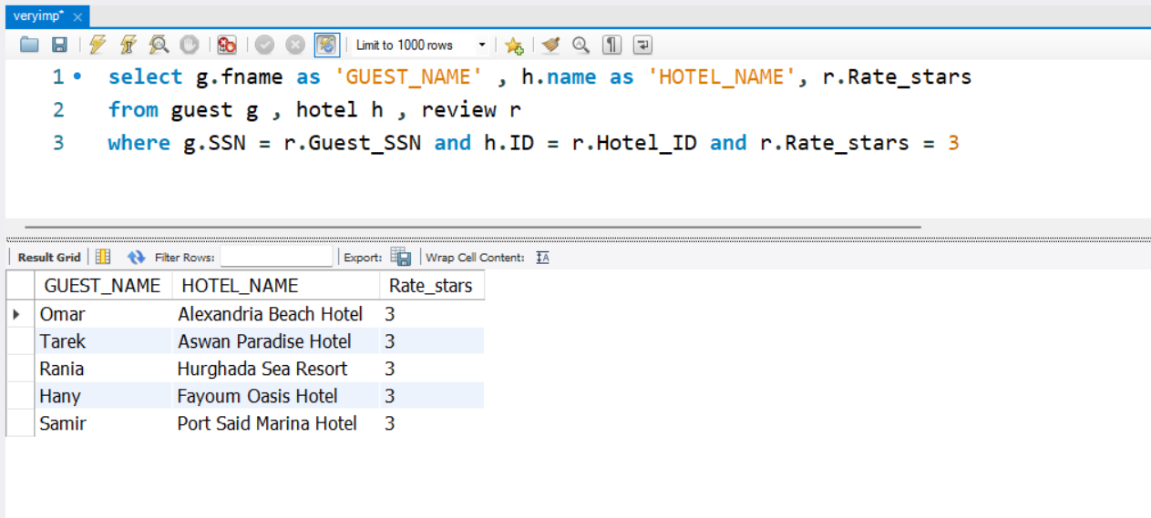
Query 4
4) retrieve the name of the guest who rate the hotel with 3 stars

Slide 28
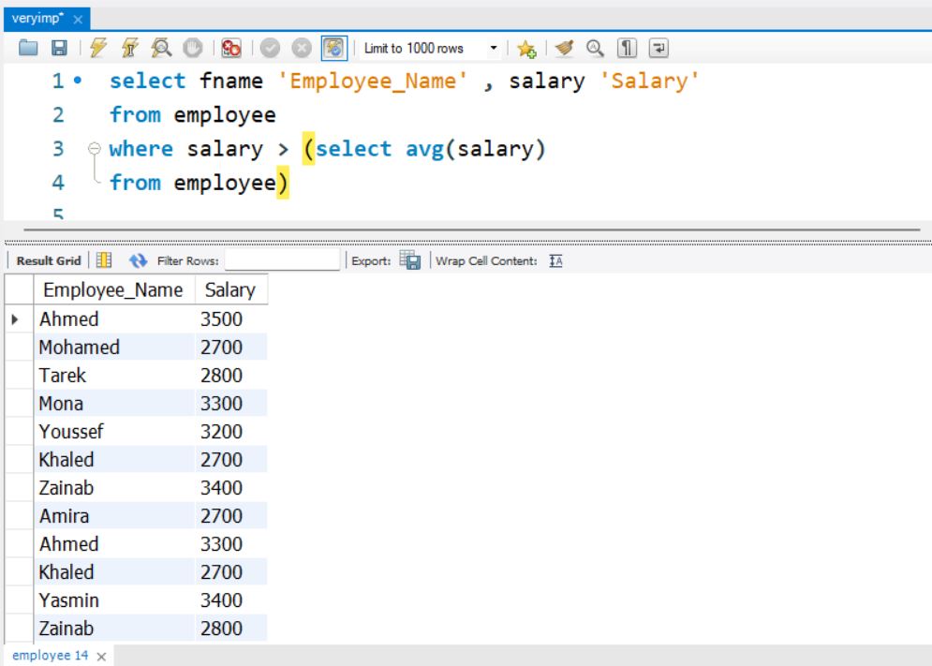
Query 5
5) retrieve the name of employee who's salary greater than average salary of employees

Slide 29
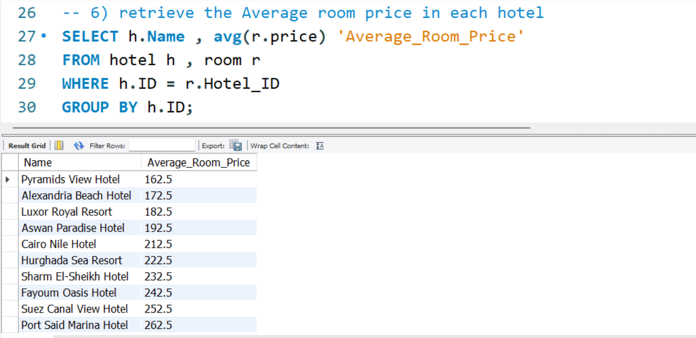
Query 6
6) retrieve the Average room price in each hotel

Slide 30
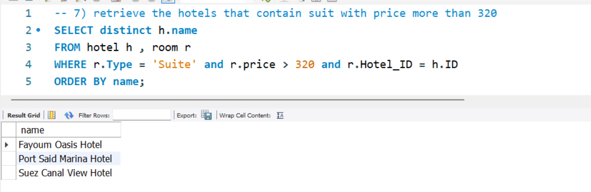
Query 7
7) retrieve the hotels that contain suit with price more than 320

Slide 31
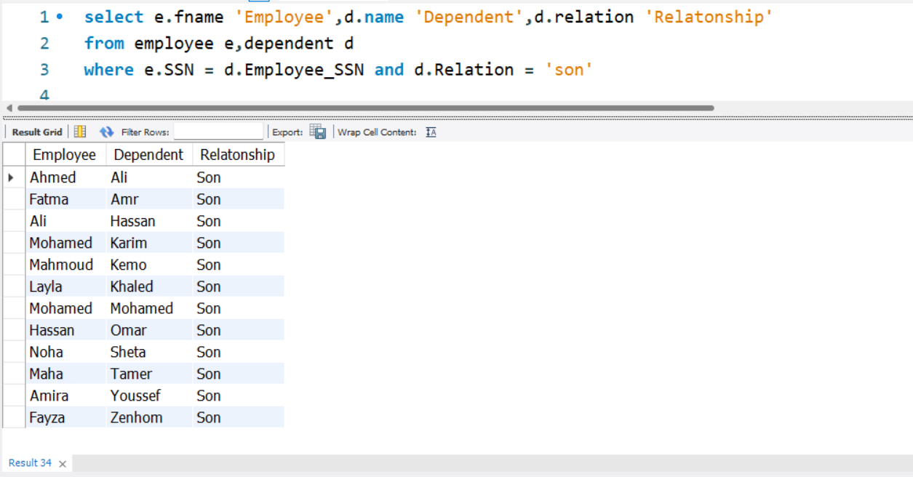
Query 8
8) retrieve the dependent name who is a son for an employee

Slide 32
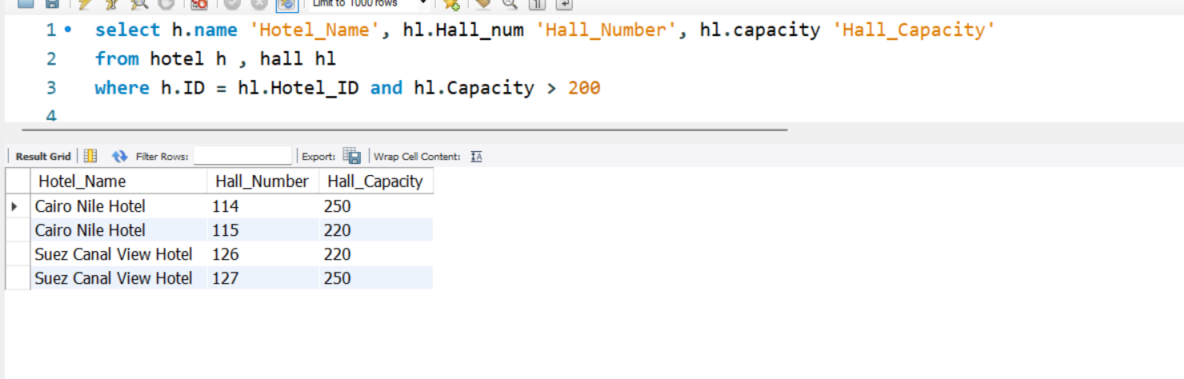
Query 9
9) retrieve the Hotels with hall capacity greater than 200

Slide 33
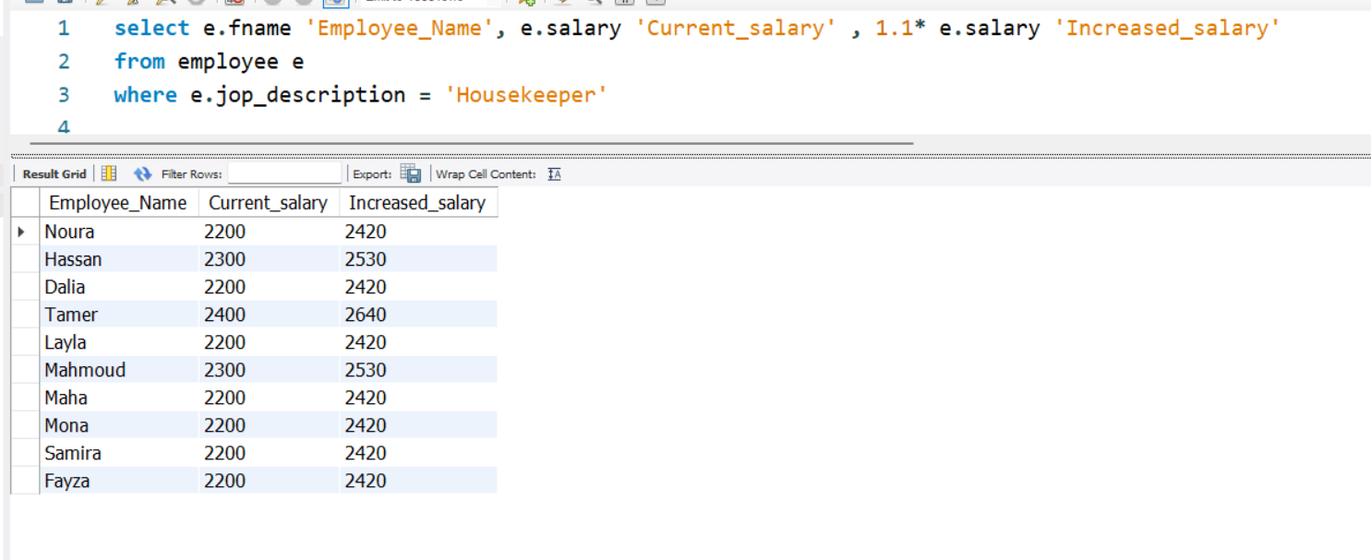
Query 10
10) retrieve the salaries of employee working as Housekeeper after increasing his/her salary by 10 percent raise

Slide 34
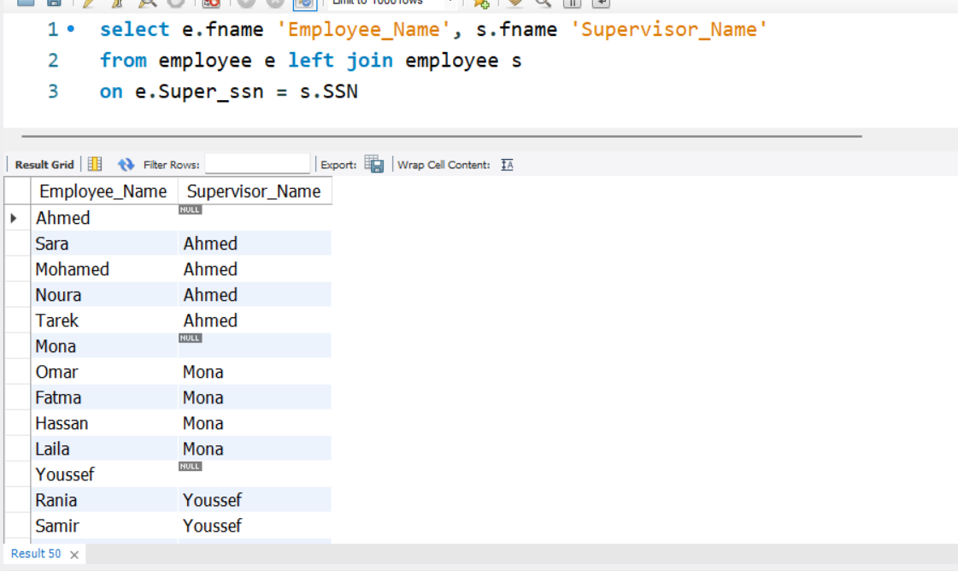
Query 11
11) retrieve the name of each employee and his/her supervisor

Slide 35
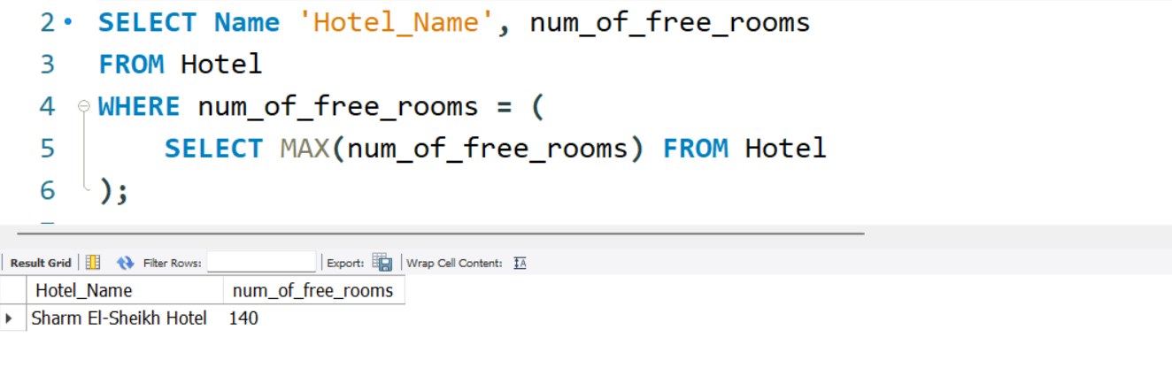
Query 12
12) retrieve the hotel with the highest number of free rooms

Slide 36
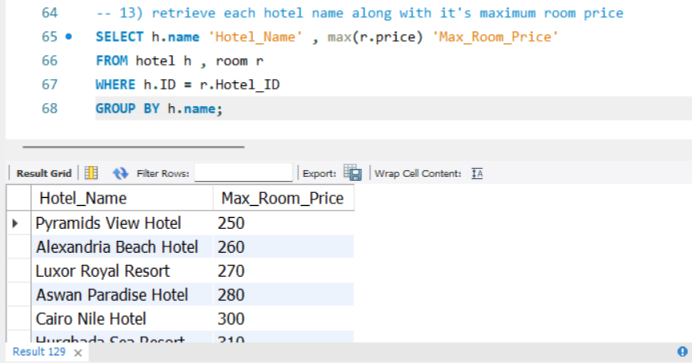
Query 13
13) retrieve each hotel name along with it's maximum room price

Slide 37
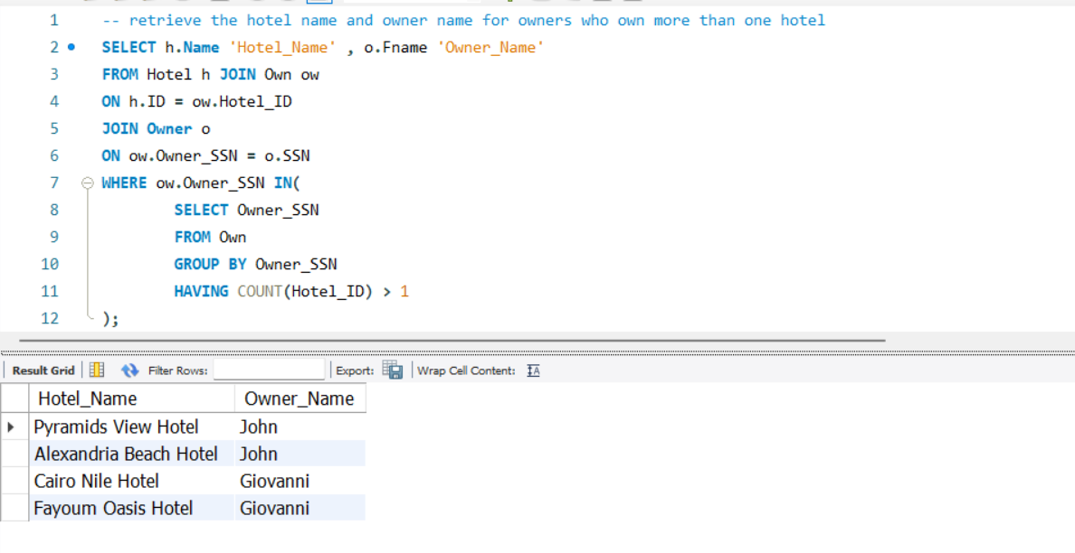
Query 14
14) retrieve the hotel name and owner name for owner who own more than one hotel

Slide 38
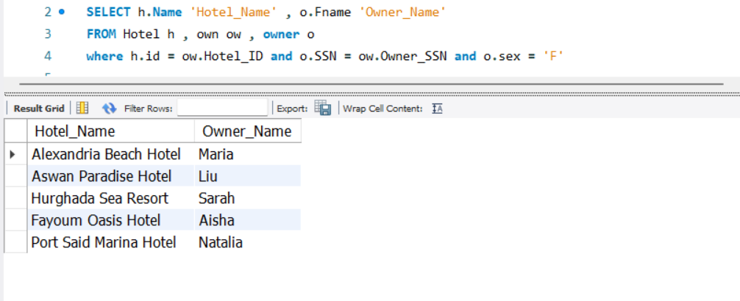
Query 15
15) retrieve the female owners for hotels

Slide 39
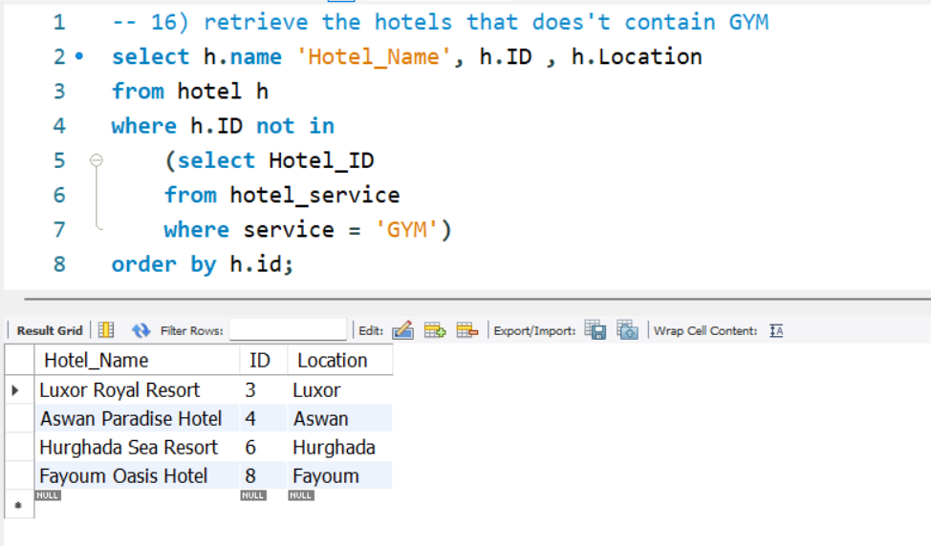
Query 16
16) retrieve the hotels that does't contain GYM

Slide 40
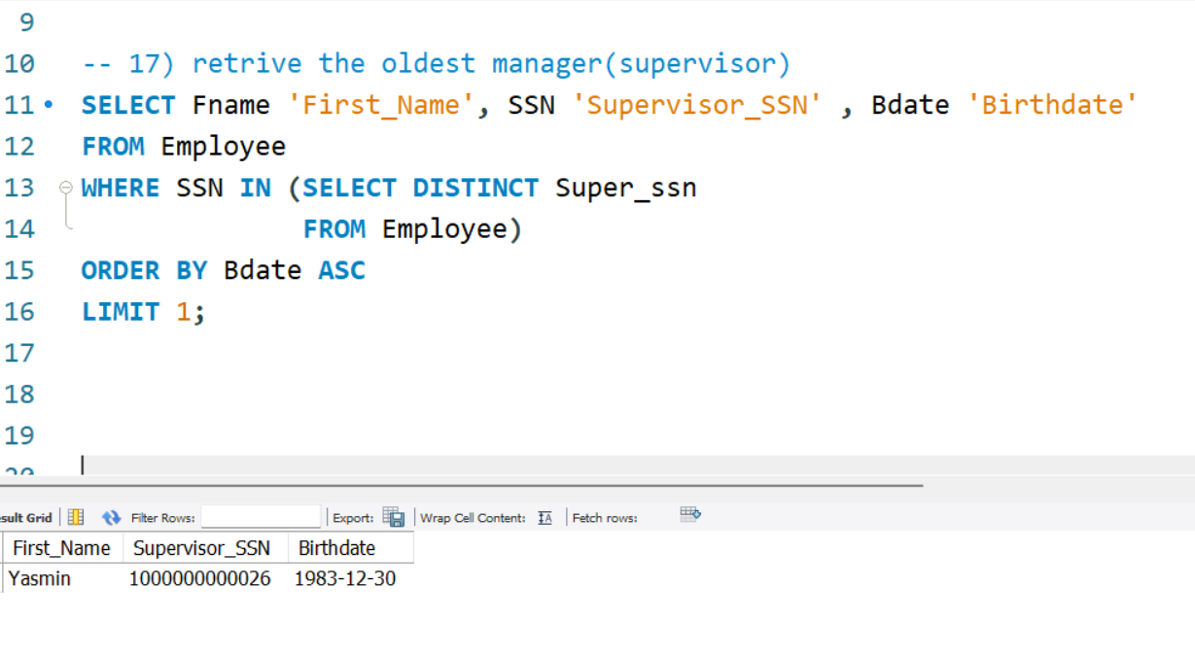
Query 17
17) retrive the oldest manager(supervisor)

Slide 41
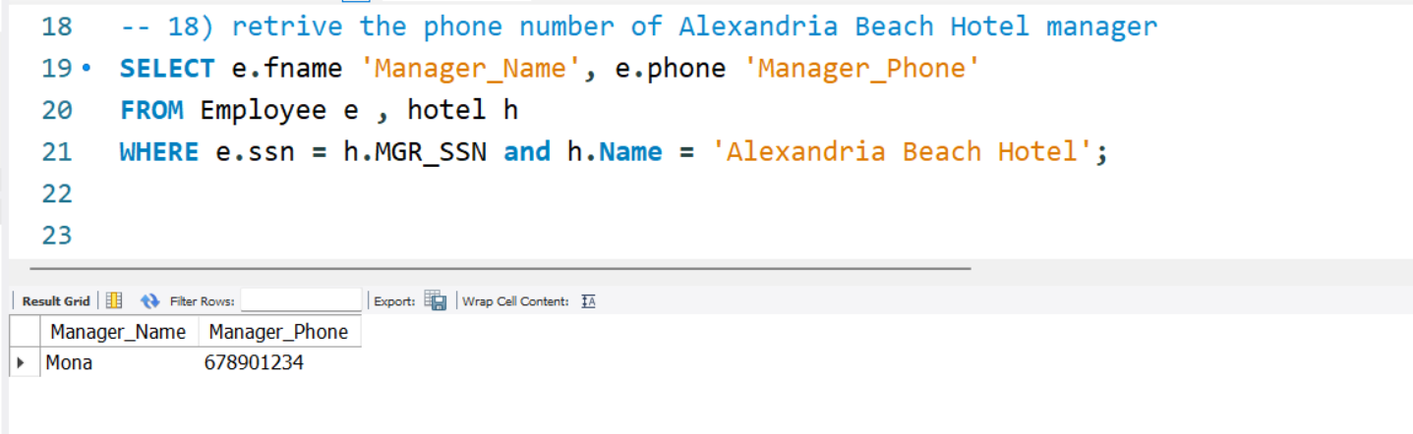
Query 18
18) retrive the phone number of Alexandria Beach Hotel manager

Slide 42
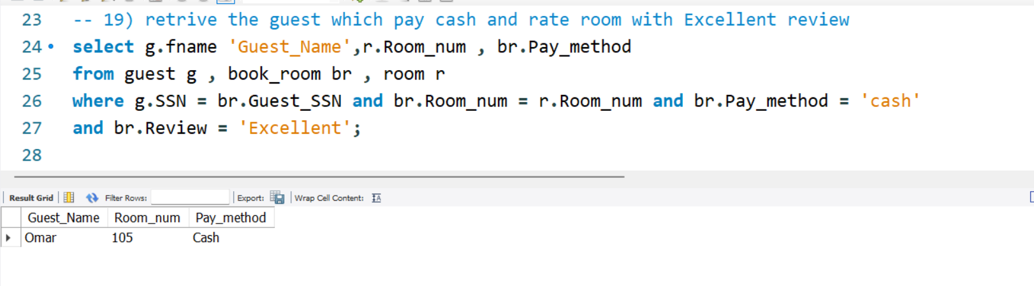
Query 19
19) retrive the guest which pay cash and rate room with Excellent review

Slide 43
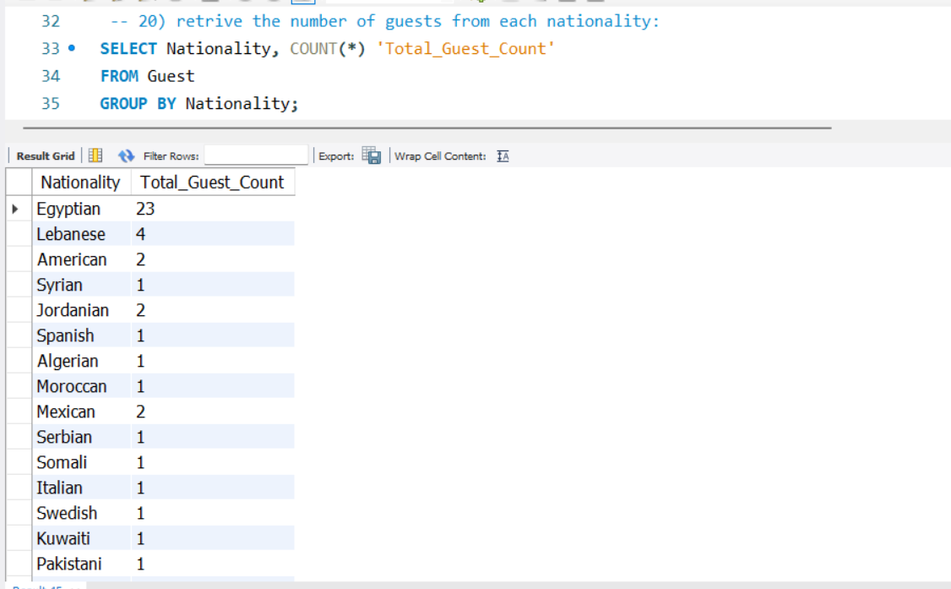
Query 20
20) retrive the number of guests from each nationality:

Slide 44
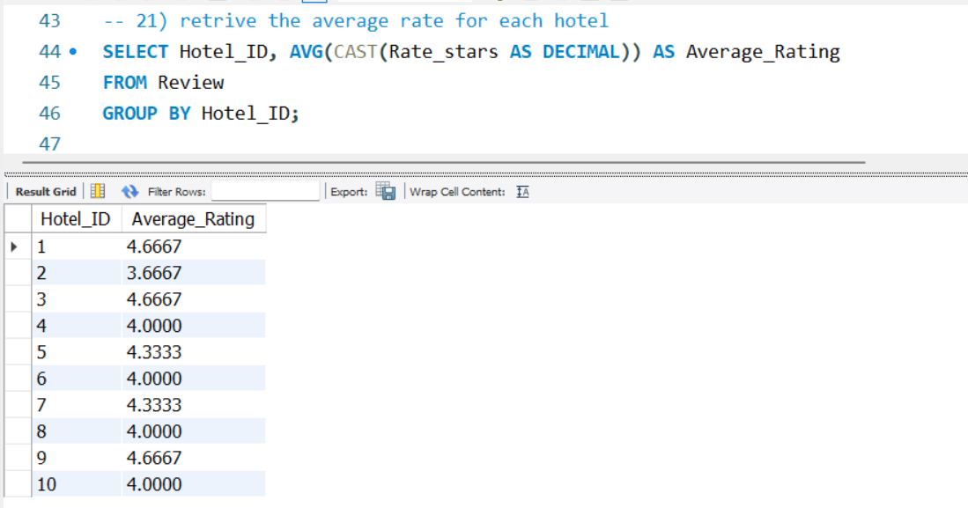
Query 21
21) retrive the average rate for each hotel

Slide 45

DATABASE
THANK YOU
9 December, 2024

